Slide 1



HMR Institute of Technology & Management
CodeBreak Event (IEEE HMRITM) 14-15 March 2019
Team Name: Uprisers Team Members Name: Aman Srivastava, Abhinav K Gupta,
Muskan Malhotra, Abhishek Saini College Name: HMR institute of Technology and management Theme: Smart Hospital
Project Name: Doctor-X~ Appointment System
In Association with:

Slide 2
Table of contents
Problem Statement
Introduction
Working Model
Conclusion
Future Scope

Slide 3
Problem statement
As we all know that the database management in hospitals now a days in rural areas are solely dependent on file system. It may lead to misplacement of data and one of the major problem in government hospitals is that there are long waiting hours in these hospitals which leads to affliction of the patient’s need.

Slide 4
Introduction
In TODAY SCENARIO,IT IS COMMONLY OBSERVED THAT HOSPITALS ARE OVERCROWDED WITH NUMBER OF SUFFERING PATIENTS SO THE QUESTION ARRISES THAT WHERE DOES THE PROBLEM LIE. CLEARLY, THIS PROBLEM OCCURS DUE TO LACK OF A PROPER DATABASE AND MANGEMENT OF THE CROWD.

Slide 5
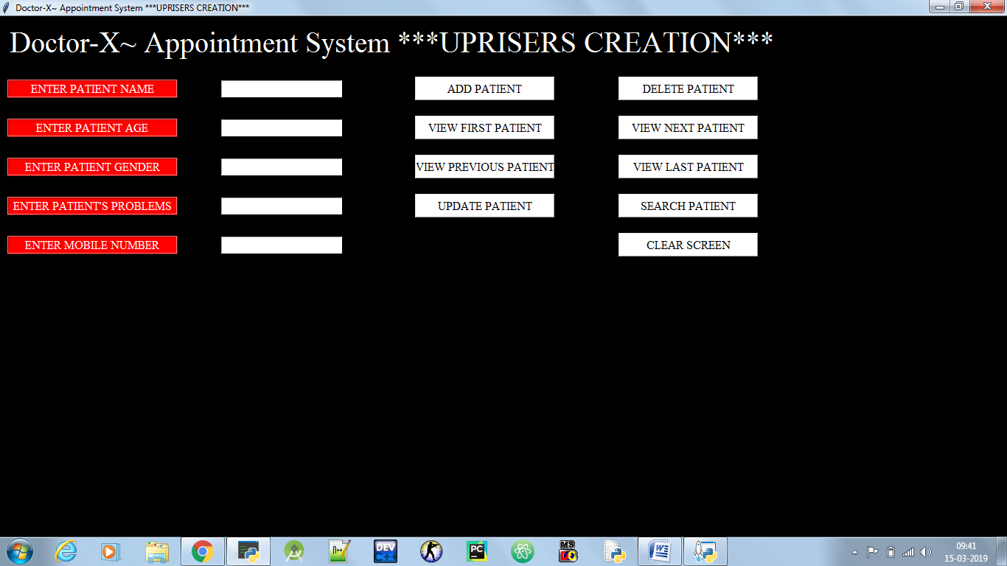
Working model
OUR PROJECT AIMS TO PROVIDE SIMPLE AND EFFICIENT INTERFACE SO THAT WE CAN DELIVER UTMOST PRODUCTIVITY TO THE MAJORITY OF PATIENTS.

Slide 6
conclusion
EFFICIENT METHODS OF CROWD MANAGEMENT
SUITABLE ADDRESSING OF THE PATIENT’S PROBLEM
EASY DATABASE MANAGEMENT
CONVINENCE TO THE PATIENTS ARE PROVIDED

Slide 7
Future scope
DIGITALIZE METHOD OF APPOINTMENTS
REDUCTION IN WAITING TIME
JOB OPPURTUNITIES INCREASED
PATIENTS WILL GET PROPER TREATMENT AND DOCTORS

